Slide 1
Scalene Works HR data Analysis
By Soubhagya Ranjan

Slide 2
Introduction
Scalene Works is true end to end IP led Talent Acquisition Organization.
Scalene has been serving companies to smoothen the process of workforce identification, hiring and managing process since 2010.
The organization thrives to achieve 100% fulfilment assurances for the clients and 200% happy candidates.

Slide 3

Problem statement
How to reduce the losses of company during hiring process ?

Slide 4
>Certain hours of effort is simply wasted by the business. As well as the HR on a particular candidate during the
sourcing
screening
>if any cost during process goes high, It also impacts the bottom line of business.
Delay in staffing the new candidate also creates a bad impact in market as well as in front of vendor.
>The Quality of resource hired after that may impact the vendor indirectly.
selection

Slide 5

How to Approach the Problem ?
Identifying the data requirement to test the hypothesis.
Data cleaning and Data exploration on the data set
Prepare Training and Test Data set
Applying various Model :
Logistic Regression
Classification Tree
Naive Bayes(BernoulliNB)

Slide 6
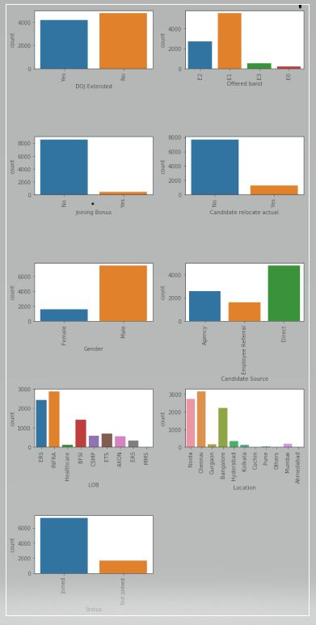
Visualizing Data

Slide 7
Inferences from Plot
A
1. Most of the candidates says 'No' to Date of Joining Extension.
B
3. Most of the candidates joined are 'MALE'
C
4. INFRA has most number of offers follwed by ERS and BFSI.
2. 8578 candidates out of 8995 not given any kind of Joining Bonus.
Male-Joined --> 6035 Not Joined --> 1409
Female-Joined --> 1278 Not Joined --> 273
5. E1>E2>E3>E0 performance of candidates having E1 is most
Candidates who are offered Band E1 out of them E1-Joined--> 4527 Not Joined--> 1041.

Slide 8
D
6. Most of the candidates actually not Relocated.
E
7.Most of the candidates came through DIRECT(4801) > AGENCY > EMPLOYEE REFERRAL
F
8. Most of the candidates got placed in
NOT RELOCATED * Joined --> 6023 Not Joined --> 1682
RELOCATED * Joined --> 1290
1 Chennai Joined --> 2486 Not Joined --> 664
2 Noida Joined --> 2362 Not Joined --> 365
3 Bangalore Joined --> 1742 Not Joined --> 488

Slide 9
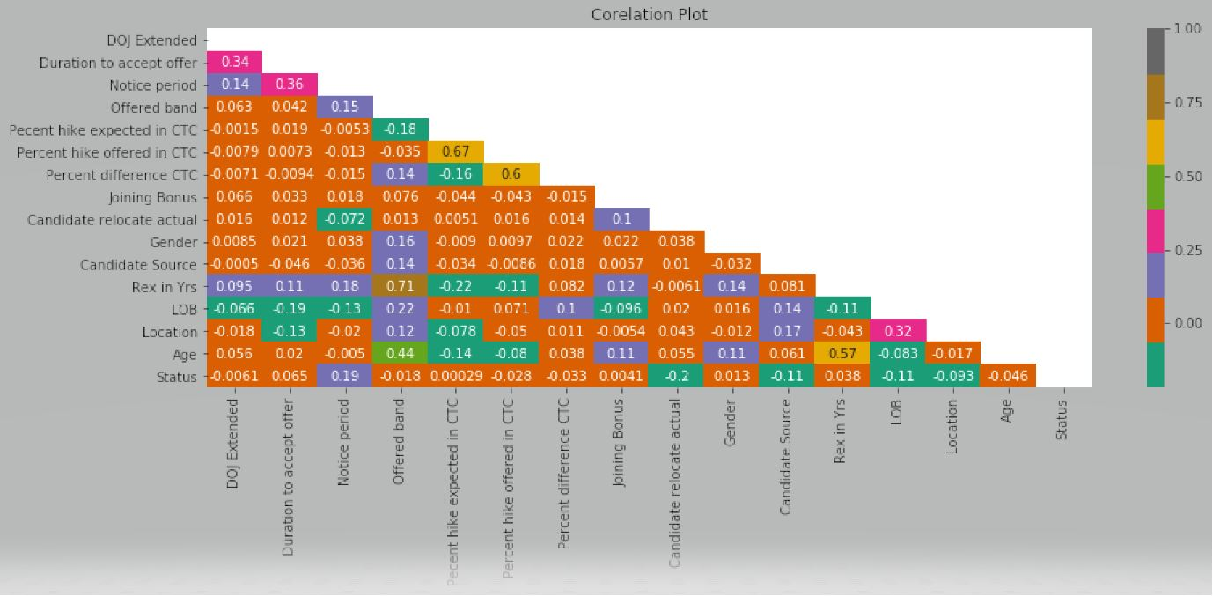
Correlation Plot

Slide 10
Inferences
1.Percentage hike offered in CTC ~ Percentage hike expected in CTC has corr factor of 0.67
2.Percentage difference CTC ~ Percentage hike offered in CTC has corr factor of 0.6

Slide 11
3.Age of the candidate ~ Years of Experience has corr factor of 0.57
5. Rex in Years(Years of exp) ~ offered Band has corr factor of 0.71
4.Age of the candidate ~ Offered Band has corr factor of 0.44

Slide 12
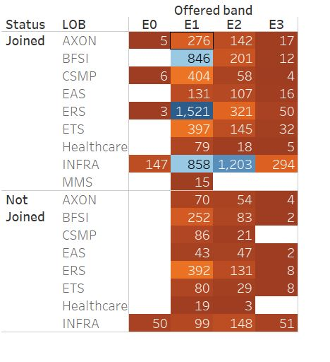
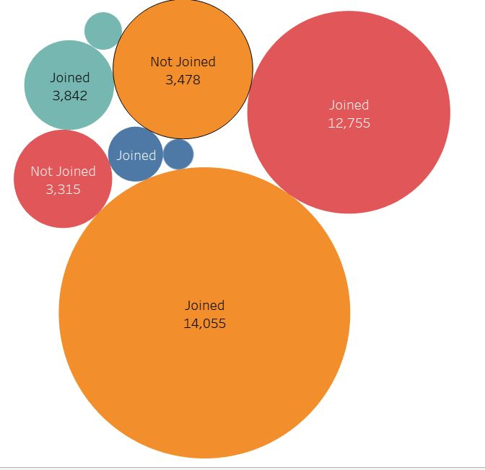
E3
E1
E0
E2
E2
E1
OFFERED BAND Vs LOB
REX in YEARS vs OFFERED BAND

Slide 13
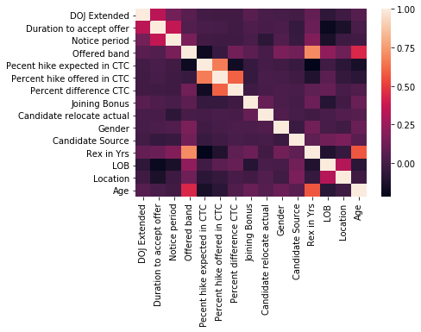
HEATMAP
Percentage hike offered in CTC vs Percentage Difference in CTC: 0.6
Age vs Offered Band : 0.4
Rex in Years vs Offered Band : 0.7

Slide 14
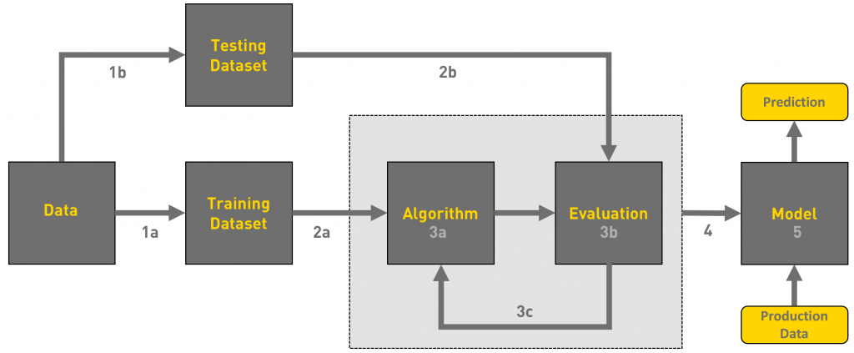
MODEL GENERATION

Slide 15
NAÏVE BAYES(BERNOULLINB)
CODES
Why I Use ?
gnb.fit(x_train,y_train)y_pred=gnb.predict(x_test)
#print('Accuracy:',metrics.accuracy_score(y_test,y_pred)*100)
print("accuracy of naive bayes algorithm ", gnb.score(x_test,y_test))
Accuracy Score 80.9894385769
It is easy and fast to predict class of test data set. It also perform well in multi class prediction
When assumption of independence holds, a Naive Bayes classifier performs better compare to other models like logistic regression and you need less training data.

Slide 16
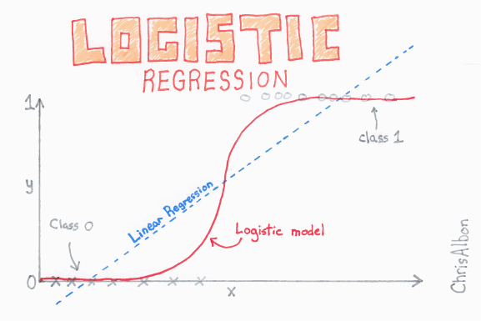

Slide 17
CODES
Why I Use ?
from sklearn.metrics import roc_auc_score
from sklearn.linear_model import LogisticRegression
log_r=LogisticRegression()
#fiting the model
log_r=log_r.fit(x_train,y_train)
print('\n Logistic Regression Model')
log_auc=roc_auc_score(y_test,log_r.predict(x_test))
print('Logistic Regression AUC = %2.2f'% log_auc)
score=log_r.score(x_test,y_test)
print('Logistic Regressor Score=',score)
Logistic regression is used for prediction of output which is binary
It gives the log of the probability of the event occurring to the log of the probability of it not occurring. In the end, it classifies the variable based on the higher probability of either class.

Slide 18
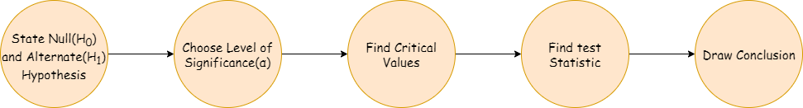
Hypothesis testing T-Test
Mean age of candidates who Joined : 30.00410228360454
Mean age of candidates who Not Joined : 29.51783590963139
1 sample T test :
Ttest_1sampResult(statistic= -5.08303165236985
p-value= 4.1290738724119264e-07)
Since the p-value is 0.000000412 <0.05 if the p-value falls lower than 5%(0.05),the null hypothesis is invalidated.
A smaller p-value bears more significance as it can tell you that the hypothesis may not explain the observation fairly.

Slide 19
CONCLUSION
1
1.Percentage hike in expected CTC need to be consider by company as most people are not willing to join.
2
2.Candidate relocate Actual, Candidate Source, LOB and Location Plays a major factor for candidates not joining after getting selected

Slide 20


